Slide 1
Implement Strassen’s Matrix Algorithm
HRITIK SHARMA (IIT2019020) SHREYANSH PATIDAR (IIT2019018) BISWAJEET DAS (IIT2019019)

Slide 2
Abstract
This Paper contains the algorithm to implement merge sort without using recursion. Two approaches have been taken and we will see the difference in complexity between both.

Slide 3
Contents
Introduction
Algorithm Design
Algorithm Analysis
Values of O(n) for all approaches
Time complexities of all algorithms and comparison b/w all
Conclusion
References

Slide 4
INTRODUCTION
In this report, we are going to discuss strassen matrix multiplication,formula of matrix multiplication and algorithms for strassen matrix multiplication.
Let us consider two matrices X and Y. We want to calculate the resultant matrix Z by multiplying X and Y. Matrix multiplication is a {binary operation} that produces a{matrix} from two matrices.
For matrix multiplication, the number of columns in the first matrix must be equal to the number of rows in the second matrix. The resulting matrix, known as the matrix product, has the number of rows of the first and the number of columns of the second matrix.
Thus the product XY is defined if and only if the number of columns in X equals the number of rows in Y.The utility of Strassen's formula is shown by its asymptotic superiority when order n of matrix reaches infinity.

Slide 5
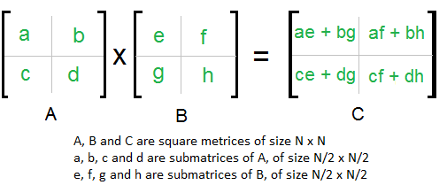
ALGORITHM DESIGN
Approach 1 (Dividing each matrix into 4 smaller matrices and performing multiplication):
Divide matrices A and B in 4 sub-matrices of size (n/2) x (n/2)
Calculate following values Recursively: ae+bg , af+bh , ce + dg and cf+dh

Slide 6
Algorithm 1:
matrix multiply( matrix A, matrix B, int n)
{
//base case
if(n==1)return A[0][0]*B[0][0];
//break matrix A and B into 4 quadrants
matrix a,b,c,d //for matrix A
matrix e,f,g,h; //for matrix B
int k = (n/2);
matrix C;
matrix c1,c2,c3,c4 //4 quadrants of matrix C
c1 = multiply(a,e,k) + multiply(b,g,k)
c2 = multiply(a,f,k) + multiply(b,h,k)
c3 = multiply(c,e,k) + multiply(d,g,k)
c4 = multiply(d,f,k) + multiply(d,h,k)
return C;
}

Slide 7
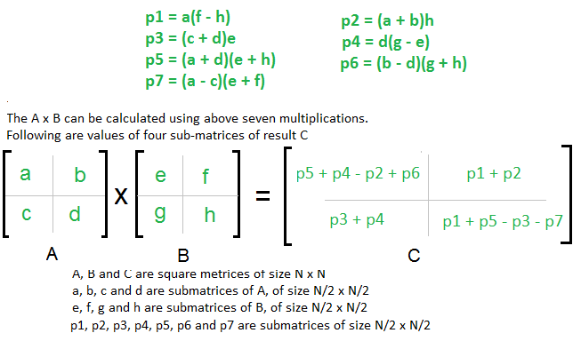
ALGORITHM DESIGN
Approach 2 (Strassens’ algorithm):

Slide 8
Algorithm
matrix multiply( matrix A, matrix B, int n)
{
//base case
if(n==1)return A[0][0]*B[0][0];
//break matrix A and B into 4 quadrants
matrix a,b,c,d //for matrix A
matrix e,f,g,h; //for matrix B
int k = (n/2);
matrix C;
matrix c1,c2,c3,c4 //4 quadrants of matrix C
matrix p1,p2,p3,p4,p5,p6,p7
p1 = multiply(a,f-h,k), p2 = multiply(a+b,h,k),
p3 = multiply(c+d,e,k), p4 = multiply(d,g-e,k),
p5 = multiply(a+d,e+h,k), p6 = multiply(b-d, g+h,k),
p7 = multiply(a-c, e+f,k),
c1 = p5+p4-p2+p6
c2 = p1+p2
c3 = p3+p4
c4 = p1+p5-p3-p7
return C;
}

Slide 9
ALGORITHM ANALYSIS
Approach 1:
The above described algorithm to divide the array into smaller components takes O(n*n*n) time complexity in both the best and worst cases. Space complexity = O(logn*n*n)
t_{best}: when n=0, = O(0) = 0 ms
t_{worst}: when n=50 , t_{worst} = O(125000)
Approach 2:
Addition and Subtraction of two matrices takes $O(N^2)$ time. So time complexity can be written as:
T(N) = 7T(N/2) + O(N^2) = O(N^log7) = O(N^2.8) time.
Space = O(logn* n^2)
t_{best}: when n=0, = O(0) = 0 ms
t_{worst} : when n=50 ,

Slide 10
VALUES OF O(N) FOR BOTH ALGORITHMS
S.No | n | Approach 1 | Approach 2
1 | 0 | 0 | 0
2 | 10 | 1000 | 88.28972194
3 | 50 | 125000 | 2023.219371
4 | 100 | 1000000 | 7795.075
5 | 1000 | 1000000000 | 688225.0043
6 | 10000 | 1000000000000 | 60763194.26

Slide 11
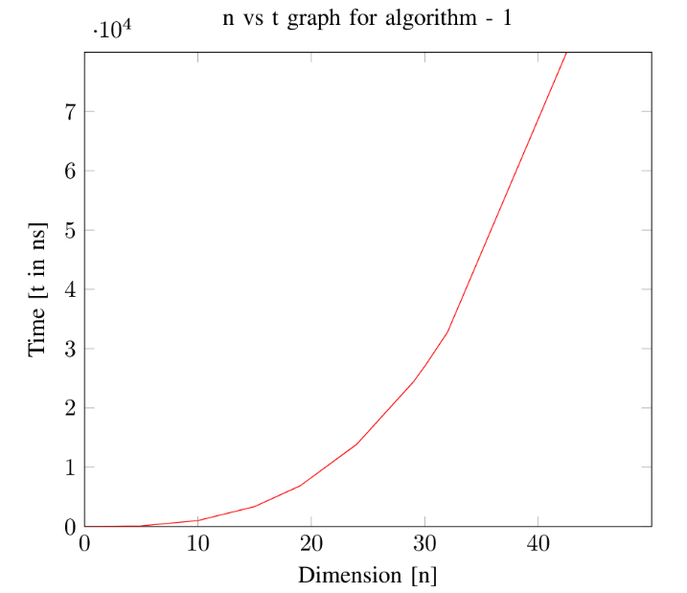
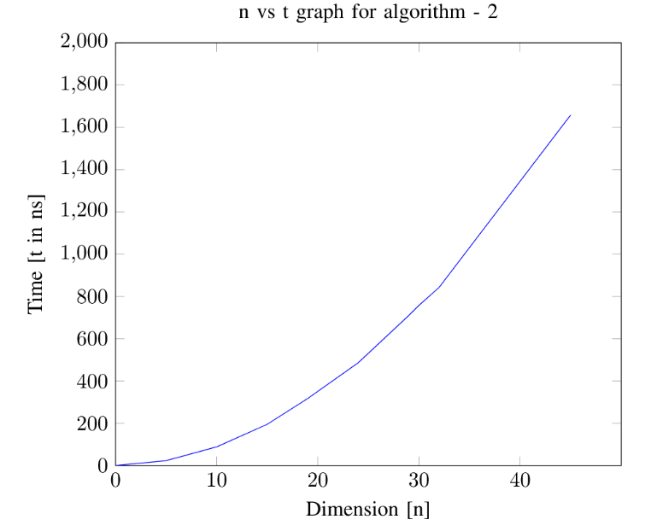
TIME COMPLEXITIES OF ALGO 1 & 2
Algo 1 Time Complexity
Algo 2 Time Complexity

Slide 12
CONCLUSION
Implementation of Strassen's algorithm for matrix multiplication is several times faster than the naïve method for matrix multiplication, if applied on large enough matrices.

Slide 13
Reference
[1].https://en.wikipedia.org/wiki/Subsequence
[2]​ https://www.geeksforgeeks.org/longest-increasing-subsequence-dp-3/
[3] ​https://www2.cs.duke.edu/courses/spring18/compsci330/Notes/dynamic.pdf

